Slide 1
VAYU-NET
The intelligence layer India's 900 air-quality sensors never had
signal → attribution → forecast → enforcement → advisory in 1.5 seconds, not 3 days
LIVE: vayu-net-ten.vercel.app
3 cities · real data
open source stack
Team: Divyaman Pal
VAYU-NET · vayu-net-ten.vercel.app · 1

Slide 2
The data exists. The intelligence layer doesn't.
900+
31%
CAAQMS sensors deployed under NCAP — measuring, not acting
of monitored cities have ANY response protocol tied to readings (CAG audit, 2024)
1.67M
~3 days
premature deaths/year from air pollution in India (Lancet Planetary Health)
typical lag from pollution signal to any coordinated intervention
Dec 16, 2025 — Bombay High Court summons BMC over toxic air. The city's answer: a source-attribution system still being designed. We built it. It's deployed.
VAYU-NET · vayu-net-ten.vercel.app · 2

Slide 3
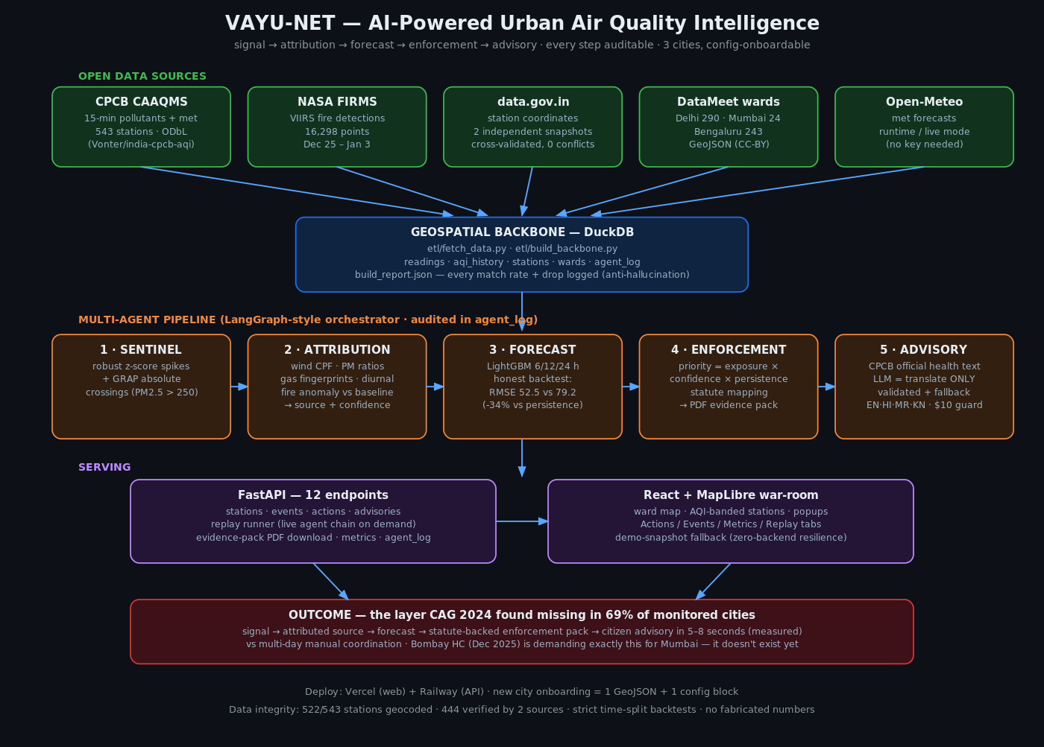
Five agents, one auditable loop
VAYU-NET · vayu-net-ten.vercel.app · 3

Slide 4
Watch it work: the New Year's Eve crisis, replayed live
t+0.28s
SENTINEL
15 pollution spike events detected across Delhi stations
t+0.41s
ATTRIBUTION
12 fireworks/burning + 3 traffic — satellite fire layer corroborating
t+0.96s
FORECAST
24h PM2.5 issued for 72 stations (RMSE 34% better than baseline)
t+1.08s
ENFORCEMENT
Top-10 wards ranked; evidence packs with legal basis generated
t+1.45s
ADVISORY
Ward-level health alerts issued for vulnerable groups
Real CPCB readings · Dec 31, 2025 18:00 – Jan 1, 2026 02:00 · every step logged to an audit table
1.46s
total, on live deployment — vs multi-day manual coordination
VAYU-NET · vayu-net-ten.vercel.app · 4

Slide 5
Source attribution that shows its evidence
Wind analysis which direction pollution arrives from (CPF)
Particle fingerprint dust vs combustion via PM2.5/PM10 ratio
A real output (Vivek Vihar, NYE):
burning/fireworks — 86.9% confidence • PM2.5/PM10 ratio 0.66 — combustion aerosol • NH3 above station's 75th percentile • 00:00 — late-night burning window • Calm winds 0.4 m/s — inversion trapping • VIIRS fire activity 3.7× period average (NASA)
The AI never invents the verdict — it fuses six measured signals into a scored, inspectable claim.
Gas signature NO2/CO=traffic · SO2=industry · NH3=burning
Time-of-day pattern rush hour vs midnight vs 24h-flat
NASA satellite fires VIIRS anomaly vs local baseline
Calendar context NYE, Diwali, stubble season priors
Validated against the Supreme Court-mandated CAQM unified inventory (Jan 2026) — side-by-side in the product, with honest notes where an episode week differs from a seasonal average.
VAYU-NET · vayu-net-ten.vercel.app · 5

Slide 6
Forecasts benchmarked the way judges asked
-34%
error vs persistence at 24h (-50% at 12h)
1 km
forecast grid, 3,107 cells, coverage honestly masked >8 km from sensors
72h
horizons trained; we print 'no honest backtest possible on one week of data' instead of inventing numbers
VAYU-NET · vayu-net-ten.vercel.app · 6

Slide 7
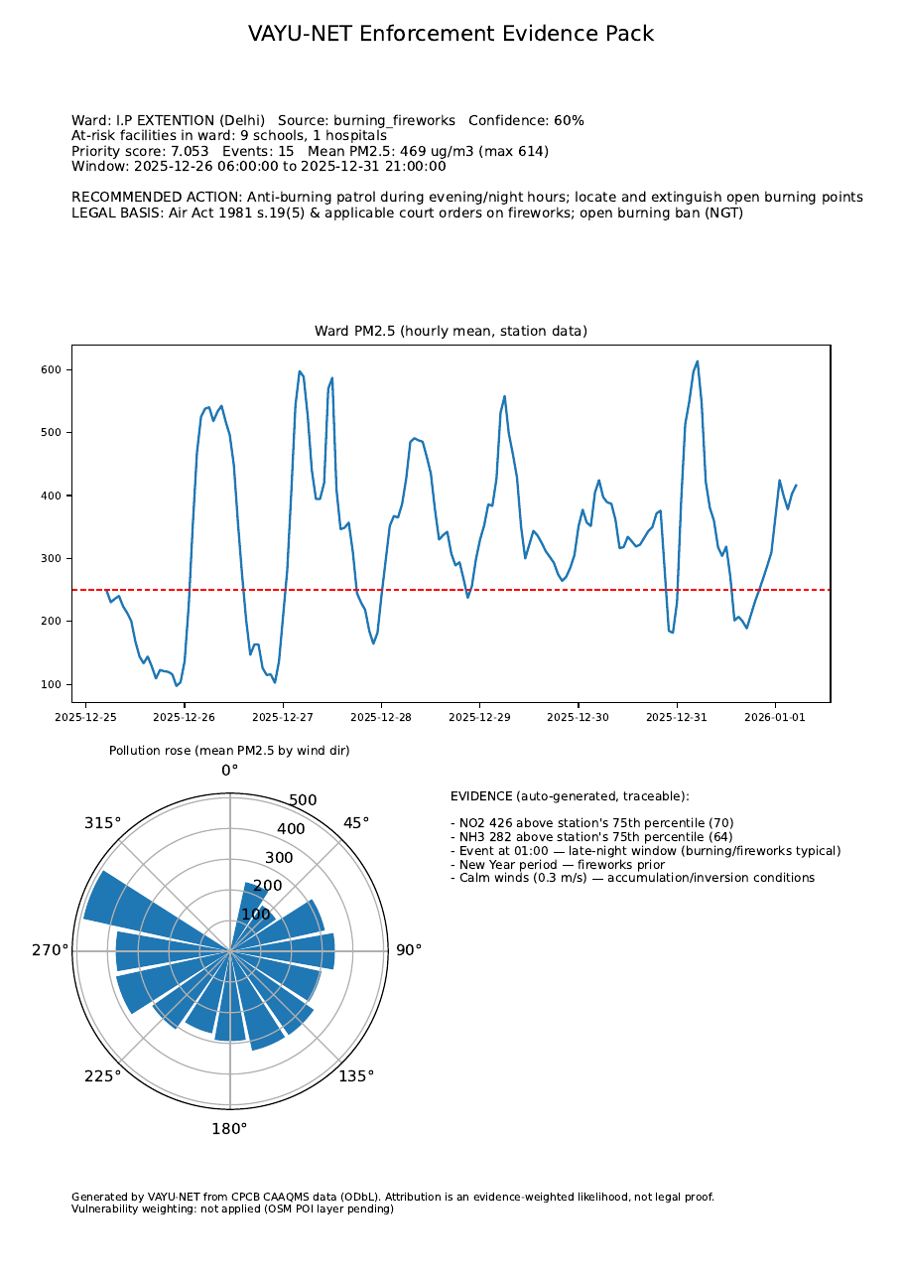
From hotspot to inspector-ready paper
priority = severity × confidence × persistence × vulnerability Severity — exposure above CPCB Moderate band Confidence — from the attribution engine (0–1) Persistence — hours the ward stayed in event state Vulnerability — real schools + hospitals in the ward (6,000+ facilities mapped from OpenStreetMap) Every recommendation ships a one-page evidence pack: ward chart · pollution rose · evidence bullets · at-risk facilities · statute mapping (Air Act s.19(5)/s.31A, C&D Rules, GRAP, MV Act) — fixed lookup, no AI near legal text
This is the exact layer the CAG found missing in 69% of monitored cities.
VAYU-NET · vayu-net-ten.vercel.app · 7

Slide 8
Citizens hear it in their language — safely
Ward-level, not city-level each of 557 wards gets its own forecast-driven alert
Live example (Rohini ward, elderly): "Air quality alert for Rohini: forecast AQI 380 (Very Poor) in the next 24 hours. Respiratory illness on prolonged exposure. Stay indoors during peak hours; keep medication at hand." Nothing in this sentence was free-generated: band text is CPCB's own wording; numbers come from the forecast table.
Vulnerable groups first schools · elderly · outdoor workers — different actions each
CPCB's official health text hard-coded per AQI band — the LLM cannot alter health claims
LLM = translation only EN · हिंदी · मराठी · ಕನ್ನಡ — validated output, template fallback, $10 hard budget cap
VAYU-NET · vayu-net-ten.vercel.app · 8

Slide 9
Three cities on day one. A fourth in 20 minutes.
City | Stations | Wards | Events (episode) | Top priority
Delhi | 40 | 290 | 800 | 7.05
Mumbai | 28 | 24 | 146 | 1.08
Bengaluru | 13 | 243 | 103 | 1.39
One scoring formula across cities → a commissioner sees instantly that Delhi's NYE week demanded ~6× Mumbai's response. Onboarding city #4: 1 ward-boundary file + 1 config block. Every data source is national: CPCB sensors, NASA FIRMS, OpenStreetMap, data.gov.in. Run cost: ~₹8k/city/month on free-tier-class infra — the intelligence layer reuses the crores already spent on sensors.
Deployed: Vercel (web) + Railway (API) — both auto-deploy from the public GitHub repo.
VAYU-NET · vayu-net-ten.vercel.app · 9

Slide 10
Built so a skeptical judge can't break it
Audit trail every agent step logged with inputs/outputs — every UI claim joins back to a database row
Cross-validated data station coordinates accepted only when two independent government snapshots agree: 444 verified, 0 conflicts
Honest metrics test window contains the hardest event; 48/72h say 'no honest backtest' instead of fake numbers; grid masks uncovered areas
Constrained AI attribution verdicts are computed, not generated; LLM only translates; legal text is a fixed lookup; $10 hard spend cap
Ground-truth check attribution shares displayed against the SC-mandated CAQM inventory — deviations explained, not hidden
Open everything ODbL/CC-BY/public data only · full pipeline reproducible with one script
VAYU-NET · vayu-net-ten.vercel.app · 10

Slide 11
India measured its air for a decade.
VAYU-NET is what acting on it looks like.
Live product: vayu-net-ten.vercel.app API: assignment-production-816f.up.railway.app Code: github.com/divyaman-pal/Assignment — Urban Air Hack
Roadmap: live CPCB feed (fetcher ships in repo) · WRF dispersion coupling · IVR rollout · NCAP city onboarding
VAYU-NET · vayu-net-ten.vercel.app · 11

